Slide 1




Implementation of Error Detection Techniques Using Parity And Checksum in C

Slide 2


INTRODUCTION
In computer networks, data is transmitted from sender to receiver.
During transmission, data may get corrupted due to noise or interference.
Error detection techniques are used to identify such errors.
Parity and Checksum are basic and widely used error detection methods.

Slide 3
ERROR DETECTION OVERVIEW
Error detection ensures data integrity.
It does not correct errors, only detects them.
Common error detection techniques :
I. Parity Check
II. Checksum
III. CRC (Cyclic Redundancy Check)
IV. Hamming Code

Slide 4
PARITY CHECK TECHNIQUE
Parity adds an extra bit to data
Based on number of 1's in the data
Two types:
Even Parity
Odd Parity
Used to detect single-bit errors

Slide 5
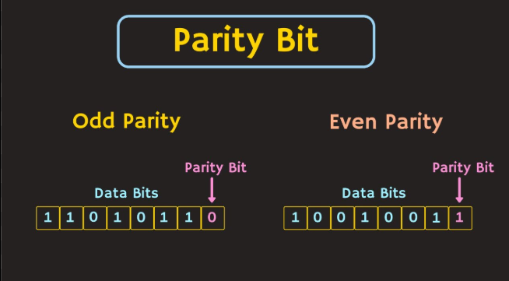
PARITY BIT & CHECKSUM
Parity is a single-bit error detection technique.
Even Parity :
Total number of 1's must be Even.
Odd Parity :
Total number of 1's must be Odd.
Sender sends data and checksum and
Receiver recalculates checksum
If both values match → No Error
If mismatch → Error Detected

Slide 6
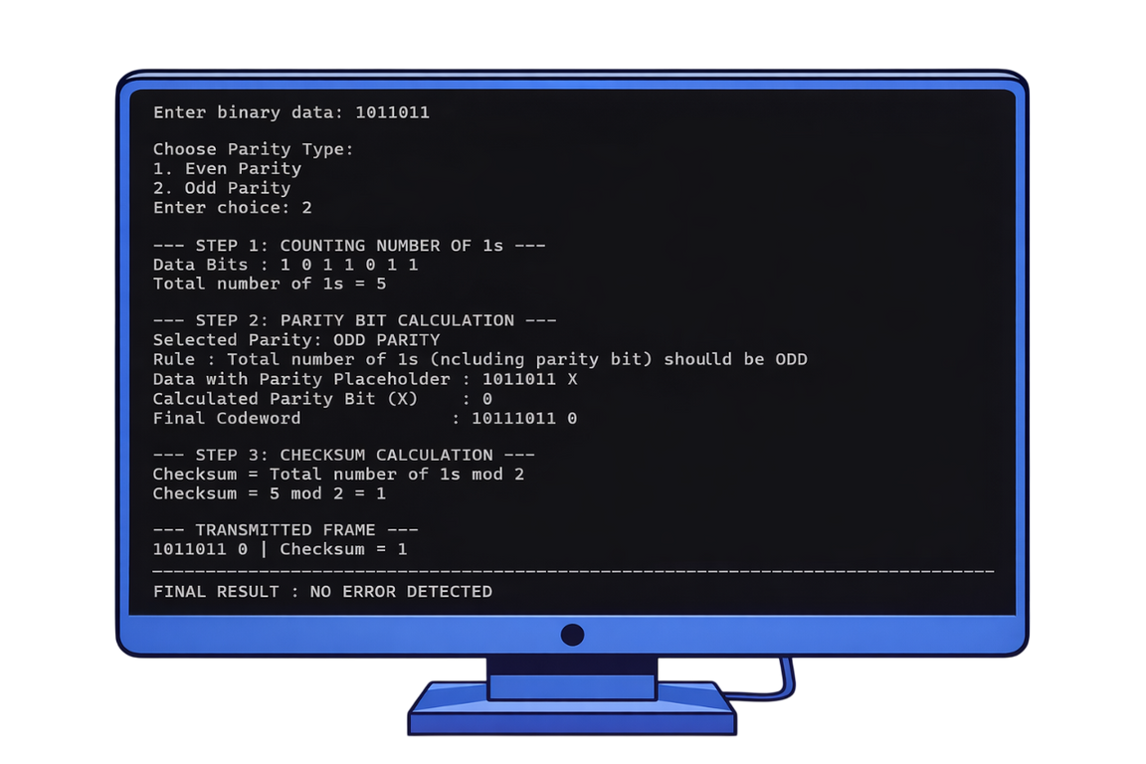
SENDER–RECEIVER SIMULATION
Sender Side:
Accepts binary data
Calculates parity bit
Calculates checksum
Transmits data + parity + checksum
Receiver Side:
Recounts data bits
Verifies parity rule
Verifies checksum
Displays error status

Slide 7
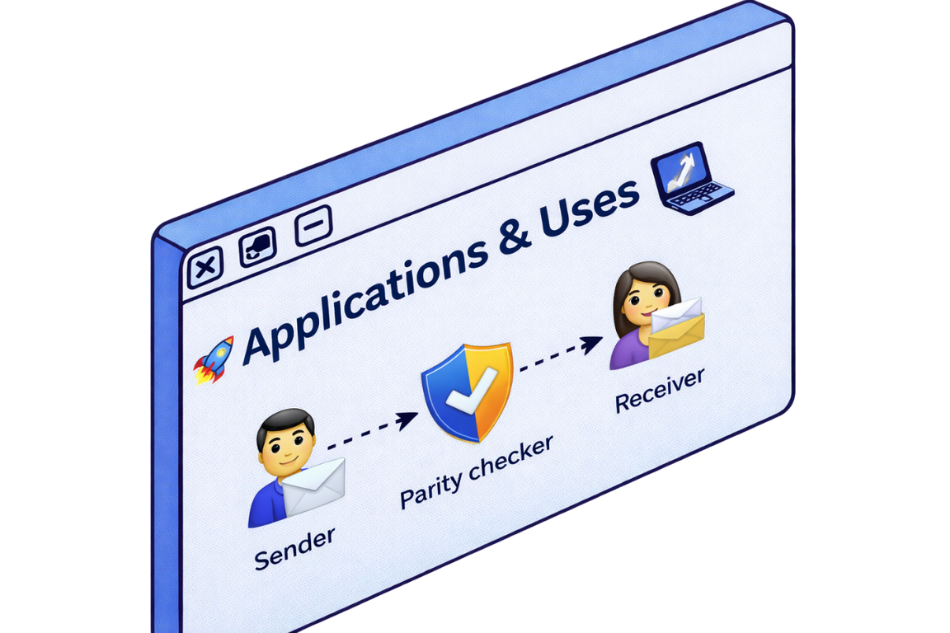
APPLICATION & USES
Data Link Layer protocols
Memory error checking
Serial communication systems
Network transmission systems
Computer hardware communication
File transfer systems
Digital communication systems

Slide 8
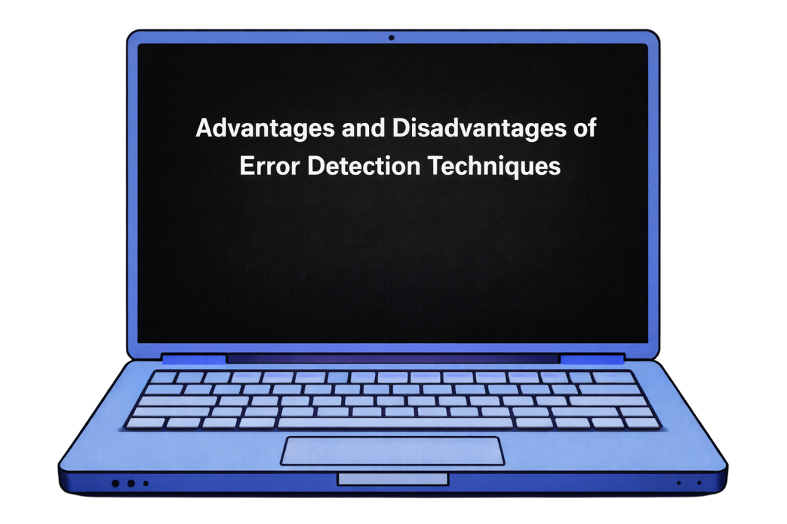
Advantages & Disadvantages
Advantages
Disadvantages
Simple and easy to implement
Requires less computation
Fast error detection
Suitable for small data transmission
Cannot locate the error position
Cannot correct errors
Multiple-bit errors may go undetected
Not suitable for high-noise environments

Slide 9
Thank You!

